Slide 1


Wind Turbine Failure Project

Slide 2

Project Leadership
Sharat Manikonda
Director at Innodatatics and Sponsor
linkedin.com/in/sharat-chandra

Slide 3
Contents
Business objective
Business Constraints
Project Architecture
Data collection and details
Exploratory Data Analysis
Visualization
Notes:
Change

Slide 4
Business Problem
Unplanned Failure of wind turbine engine is leading to huge losses and electricity generation is negatively impacted.
Business Objective: Minimize unplanned failure
Business Constraint: Maximize power generation

Slide 5
Project Overview and Scope
Success Criteria:
Business Success Criteria: Reduce the unplanned failure of wind turbine engine by at least 30%
Economic Success Criteria: Achieve a cost saving of at least $2M per year due to reduction of unplanned downtime.

Slide 6
Data Dictionary
Column Name | How is it measured | Column Description | Column values understanding | Description of levels (if applicable) | Any Additional details
date | yyyy/mm/dd | Date on which failure occurred | date is between 2021 and 2022 |  | Categorical
Wind_speed | m/s | Speed of the wind at the time of failure | float values from -5 to 54 |  | Ratio
Power | kW | Power generated by the turbine | float values from 0 to 11 |  | Ratio
Nacelle_ambient_temperature | °C | Temperature around the container containing main components of wind turbine | float values from -263 to 293 |  | Interval
Generator_bearing_temperature | °C | Temperature of generator bearing | float values from 10 to 144 |  | Interval
Gear_oil_temperature | °C | Temperature required to maintain for maintaining optimum amount of lubricant | float values from 50 to 129 |  | Interval
Ambient_Temperature | °C | Temperature around turbine | float values from -20 to 84 |  | Interval
Rotor_Speed | RPM | Directly proportional to the power generation | float values from 0.048 to 449.61 |  | Ratio
Nacelle_temperature | °C | Temperature inside nacelle which covers main components of wind turbine | float values from -19.92 to 118.076 |  | Interval
Bearing_temperature | °C | Temperature of the bearing inside wind turbine | float values from 10.02 to 149.949 |  | Interval
Generator_speed | RPM | Speed of generator used for generating alternating current (AC) | float values from 301.024 to 4003.655 |  | Ratio
Yaw_angle | ° | Aligning the rotor with the wind direction | float values from 0.0148 to 179.959 |  | Interval
Wind_direction | ° | Aligning turbine with the wind direction, generating maximum amount of energy | float values from -416.325 to 636.424 |  | Interval
Wheel_hub_temperature | °C | Hub temperature where the fans of the wind turbine are attached | float values from -89.889 to 119.932 |  | Interval
Gear_box_inlet_temperature | °C | Temperature inside gearbox which increases efficiency | float values from 10.0 to 119.965 |  | Interval
Failure_status | categorical | Status used to assess the operational health of the turbine | Failure or No Failure |  | Nominal

Slide 7
Exploratory Data Analysis [EDA]
Univariate Analysis: Wind speed has a wide range of variations similar to temperature, according to that we have a very short range of variations for power
Bivariate Analysis: Here we can find clustered correlation between different columns with a particular column
Notes:
EDA is used for seeing what the data can tell us before the modeling task.
Change

Slide 8
Data Preprocessing
Removing Missing Values
No duplicate values found
Removed outliers using IQR approach
Mostly every type of temperature has strong or moderate correlation with temperature sensitive features like wind speed etc.
Notes:
Keep observations

Slide 9
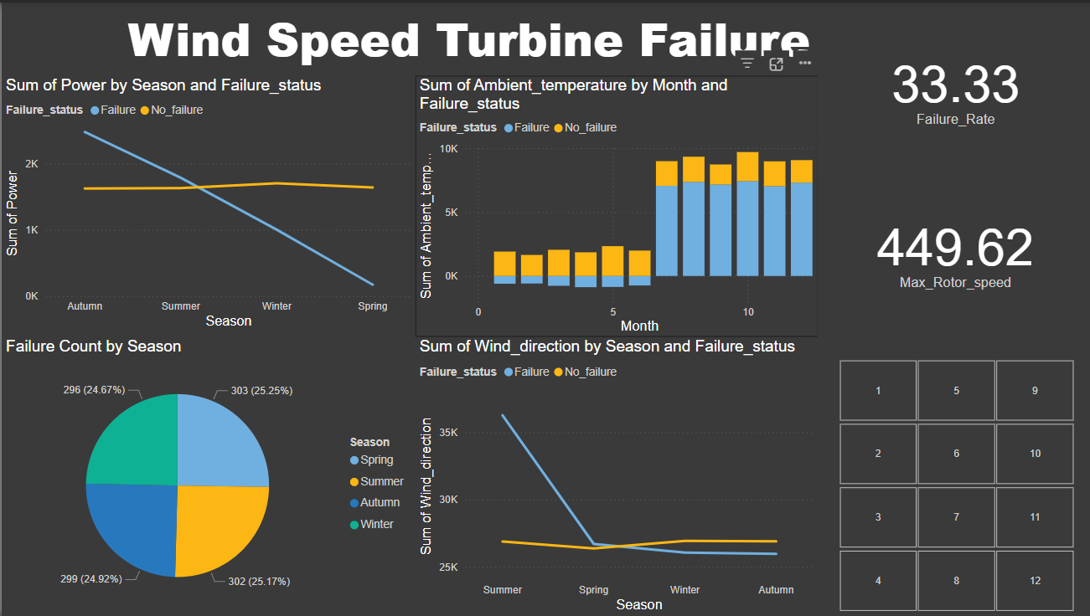
Data Visualization
Notes:
Add graphical

Slide 10


